Slide 1

what is ‘pop’ music through k-means clustering
“One good thing about music, when it hits you, you feel no pain.” -Bob Marley
Notes:
Why music genres are outdated
Today, musical genres are almost an outdated construct, With the increased diversity in music that we have seen on streaming platforms such as Spotify, Apple Music, and Soundcloud resulting in the lines separating genres grorwing more blurred by the day
Genre labels are today a broad umbrella terms that are used to describe music that vary greatly in their characteristics, and are constantly in a state of evolution
For instance, If someone says they are a fan of pop music, how do you know if they are referring to Michael Jackson or Justin Bieber?
To think of it like this – genring today is akin to supervised learning, with us already having pre-determined ideas of what things should approximately be when they fall into certain categories, be it jazz or rock, however applying an unsupervised learning model upon an art-driven dataset to see how it interprets the results, is truly fascinating
By doing this, we can cross the boundaries imposed by genre classification, findings similarities among music instead of being bound by the subjectivity of genres. We aren’t necessarily rewriting music genres, as music genres have cultural and historical nuances that even the most robust machine learning algorithms can’t strip down. Rather, clustering based on audio features augment music genres and allows us to derive more descriptive subgenres based on the audio features from a track.
Hence, this brings us to the question of – what is pop music, today?

Slide 2
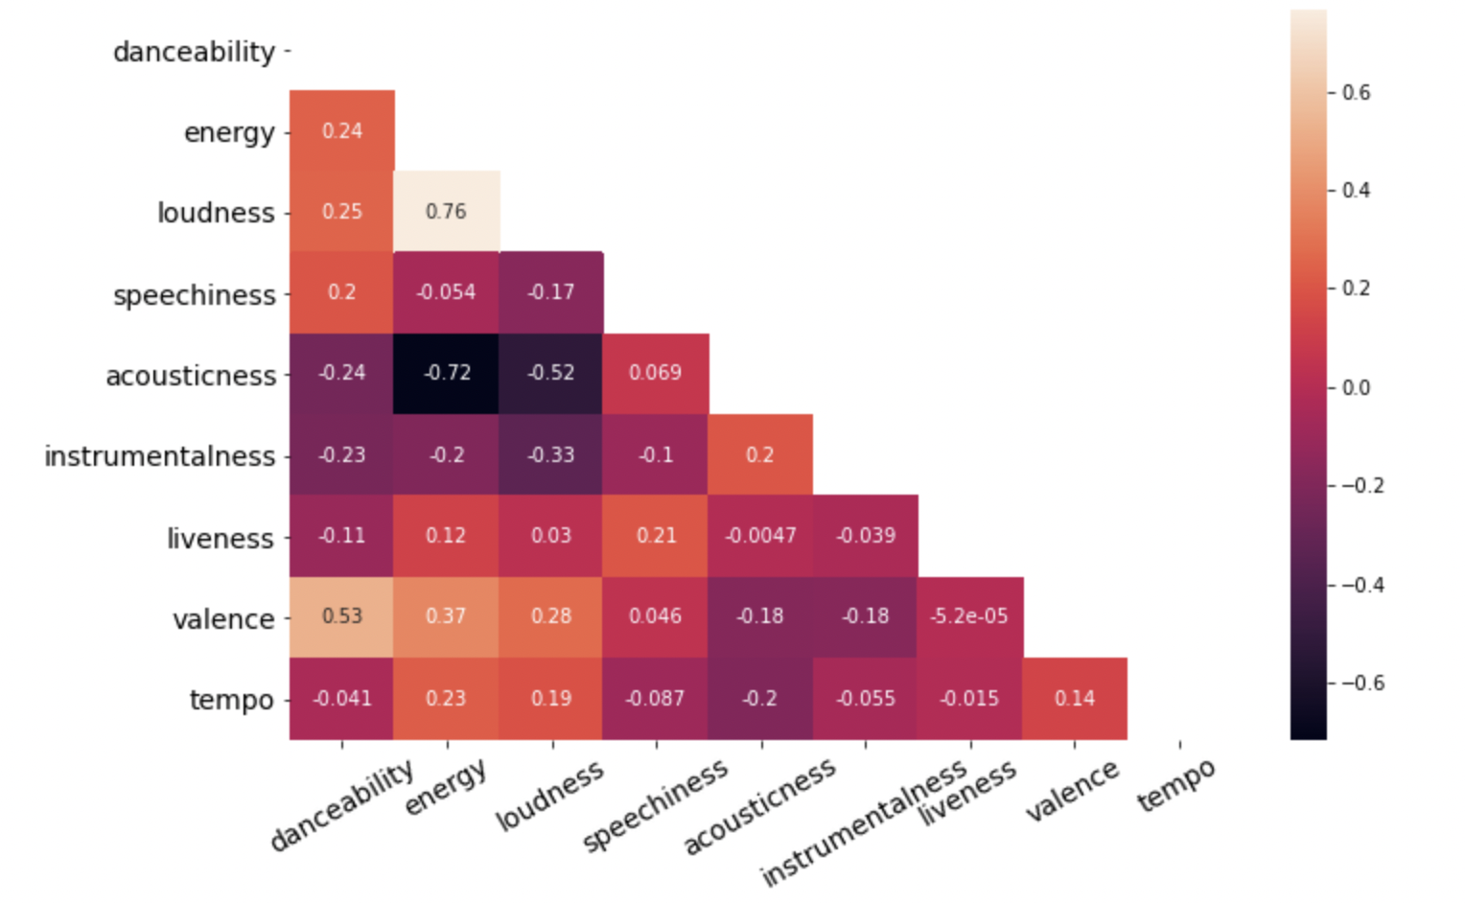
Data
DANCEABILITY
ENERGY
LOUDNESS
SPEECHINESS
ACOUSTICNESS
LIVENESS
VALENCE
Notes:
DATASET
I extracted the most popular songs listened to in Australia over the last 15 years, and using the spotify API I found these backend characteristics that spotify apply to every song. These terns are those listed.
Now as you can see, these features aren’t exactly ‘musical’ and spotify hasn’t disclosed the methology in which it classifies these labels, meaning theres a bit of interpretability, however to best describe a few of them
Danceability describes how suitable a track is for dancing based on a combination of musical elements including tempo, rhythm stability, beat strength, and overall regularity. A value of 0.0 is least danceable and 1.0 is most danceable.
Energy is a measure from 0.0 to 1.0 and represents a perceptual measure of intensity and activity. Typically, energetic tracks feel fast, loud, and noisy. For example, death metal has high energy, while a Bach prelude scores low on the scale. Perceptual features contributing to this attribute include dynamic range, perceived loudness, timbre, onset rate, and general entropy.
Loudness – how much the sound frequencies vary themselves, with 1 being a song that fluctuates from whispering to a double bass, drums and maybe an organ too coming in at the same time
speechiness: Speechiness detects the presence of spoken words in a track. The more exclusively speech-like the recording (e.g. talk show, audio book, poetry), the closer to 1.0 the attribute value. Values above 0.66 describe tracks that are probably made entirely of spoken words. Values between 0.33 and 0.66 describe tracks that may contain both music and speech, either in sections or layered, including such cases as rap music. Values below 0.33 most likely represent music and other non-speech-like tracks.
liveness: Detects the presence of an audience in the recording. Higher liveness values represent an increased probability that the track was performed live. A value above 0.8 provides strong likelihood that the track is live.
valence: A measure from 0.0 to 1.0 describing the musical positiveness conveyed by a track. Tracks with high valence sound more positive (e.g. happy, cheerful, euphoric), while tracks with low valence sound more negative (e.g. sad, depressed, angry).
As you can see from the correlation matrix, they mostly don’t correlate within themselves, except for loudness and energy, wich makes plenty of sense.

Slide 3
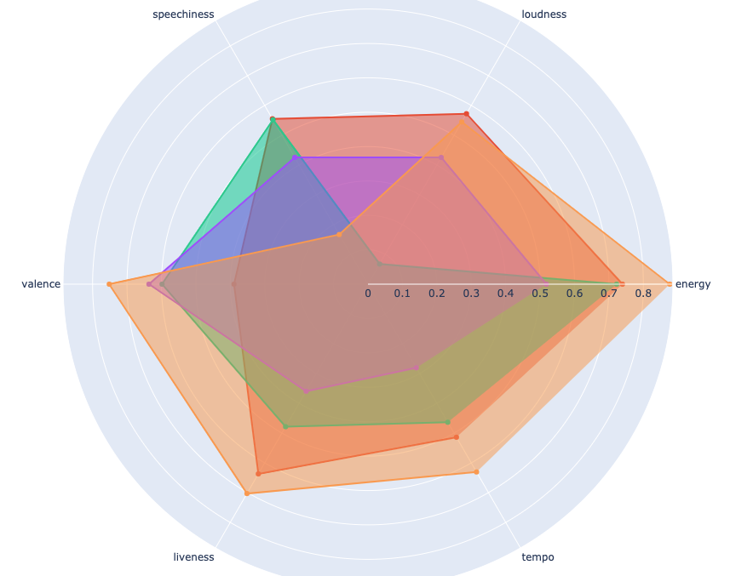
How my clusters relate to original audio features
Notes:
From here, I made a predictive model using gaussian k means clustering stating the probability in which a song will fit within my clustering ‘subgenres’
I used a probability based model, as there is obviously a great deal of subjectivity with this.
To better say, if we were, for instance trying to classify a dog from a cat, theres no subjectivity to it, its either a dog or a cat
However – for music, one persons interpretation of rock, may be another persons interpretation of folk, as an example, with this subjectivity better reflected through a probability of something belonging within a genre, then an outright classification
From this, I achieved 5 distict clusters/’subgenres’, that seem to encapsulate the main components as to what is pop music in Australia
As you can see from this right, This showing how my clustering ‘subgenres’ relate to the audio features of the tracks – themselves, abd ill show the breakdown of this in a moment.

Slide 4
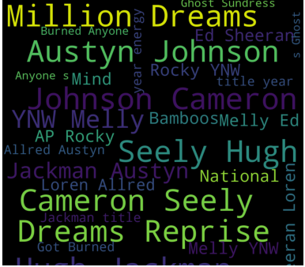
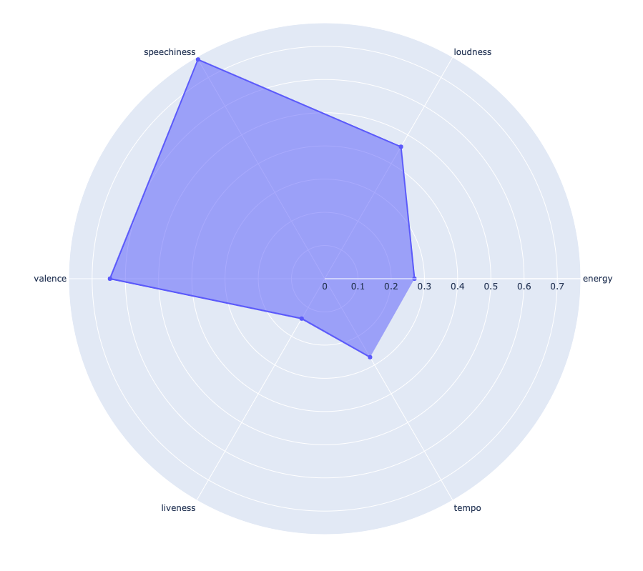
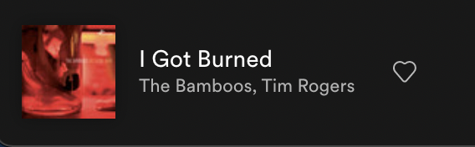
How my clusters relate to original audio features
CLUSTER 0 – Lyrical, acoustic
Notes:
The song being played being the song that ‘best’ describes the specific component that derive what makes – cluster 0

Slide 5
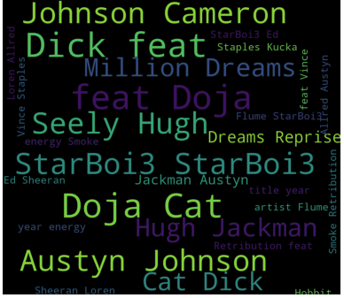
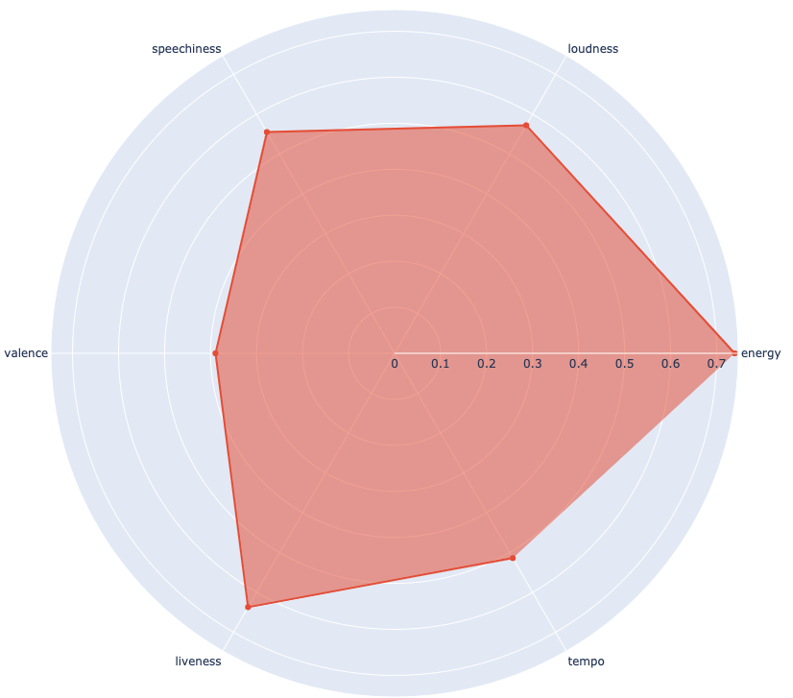

How my clusters relate to original audio features
CLUSTER 1 – Upbeat, rap-focused dance
Notes:
Flume

Slide 6
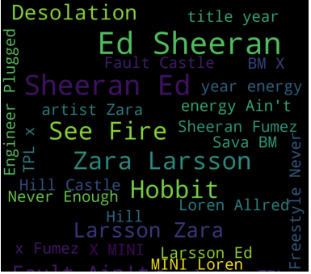
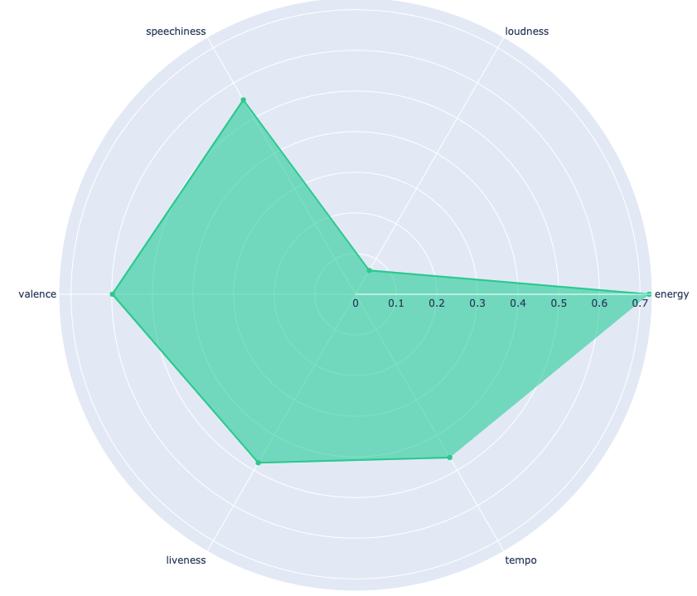
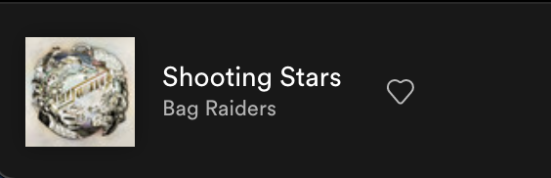
How my clusters relate to original audio features
CLUSTER 2 – Acoustic indi/pop rock
Notes:
bag raiders
Some ed

Slide 7
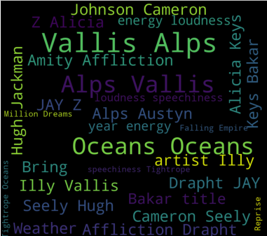
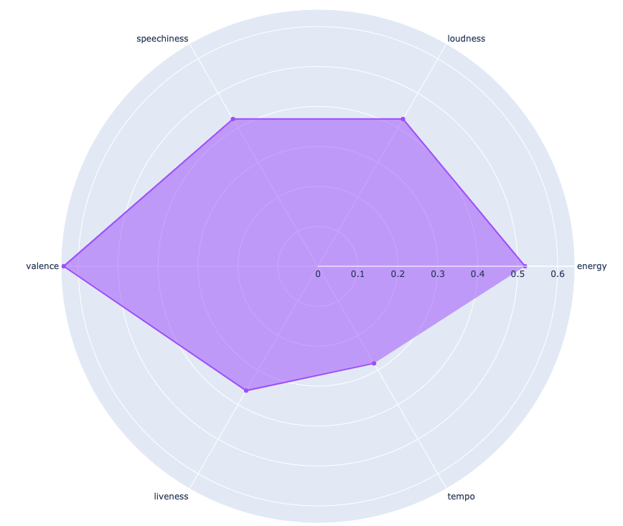

How my clusters relate to original audio features
CLUSTER 3 – Powerful, synth-based upbeat rock
Notes:
Like kygo, arianna grand

Slide 8
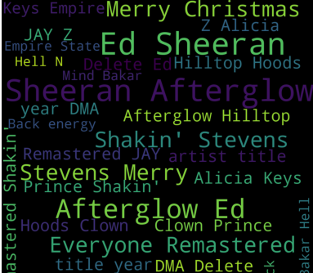
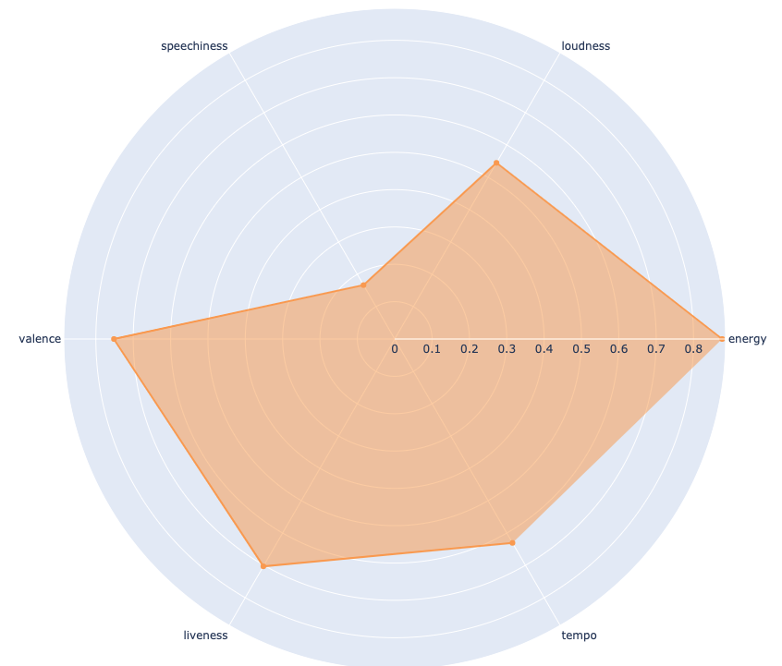

How my clusters relate to original audio features
CLUSTER 4 – High production w/ interlinked vocals
Notes:
High production value intertwined with mellow vocals
Featuring lady gaga, taylor and rufus to name a few

Slide 9

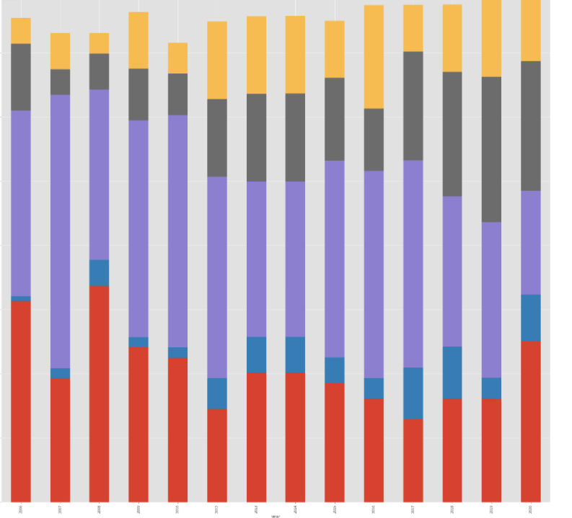
FINDINGS -
C0 – Lyrica/ acoustic
C1 – Upbeat, rap-focused dance
C2- Acoustic indi/pop rock
C3 - Powerful, synth based upbeat rock
C4 - High production with interlinked vocals
2007
2020
Notes:
The age of indi rock being at the forefront seems to be on the demise
With this supplemented by The rise of arianana grand and the r&b she uses being displayed through the rise of the gray

Slide 10
Further genre classification
FURTHER RESEARCH
Notes:
Ive got the framework here, to play with any genre now.
Create a proper recommender app showing a multitude of genres
Essentially, I can nail in to any genre, be it new age jazz to something like ‘mumble rap’ , resulting in me be able to say to someone, ‘boy do I have a song for you’, no matter what genre they fancy.
And from there create in depth recommender engines using this clustering to find what people to hear
Thank you

